Slide 1
FURCATION: INVOLVEMENT AND TREATMENT
RUNGTA COLLEGE OF DENTAL SCIENCES AND RESEARCH,BHILAI
PRESENTED BY:
Dr Sonika Bodhi
Reader
Dept. of Periodontology

Slide 2
SPECIFIC LEARNING OBJECTIVES
CORE AREAS | DOMIN | CATEGORY
Introduction | Affective | Desire to know
Definition | Cognitive | Must to know
Classification | Cognitive | Must to know
Etiological factors | Cognitive | Nice to know
Treatment | Cognitive | Must to know

Slide 3
CONTENTS
INTRODUCTION
DEFINITION
CLASSIFICATION
ETIOLOGICAL FACTORS
TREATMENT
CONCLUSION

Slide 4
INTRODUCTION
The presence of furcation involvement is one clinical finding that can lead to a diagnosis of advanced periodontitis and potentially to a less favorable prognosis for the affected tooth or teeth.
Furcation involvement therefore presents both diagnostic and therapeutic dilemmas.

Slide 5
DEFINITION
The FURCATION is an area of complex anatomic morphology that may be difficult or impossible to debride by routine periodontal instrumentation.
FURCATION INVOLVEMENT – invasion of the bifurcations/ trifurcations of multirooted tooth by periodontal disease.

Slide 6
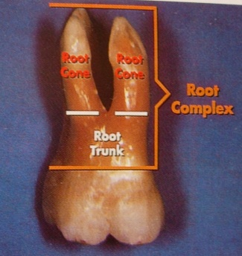

Slide 7
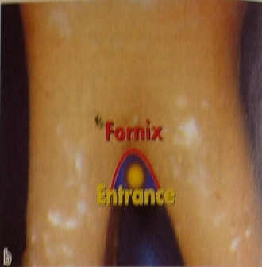

Slide 8
CLASSIFICATION
GLICKMAN IN 1953
GRADE I
GRADE II
GRADE III
GRADE IV

Slide 9
ETIOLOGIC FACTORS
Bacterial plaque and the inflammatory consequences that result from its long-term presence.
Local anatomic factors (e.g., root trunk length, root morphology)
Local developmental anomalies (e.g., cervical enamel projections).
Notes:
Local factors may affect the rate of plaque deposition or complicate the performance of oral hygiene procedures, thereby contributing to the development of periodontitis and attachment loss.

Slide 10
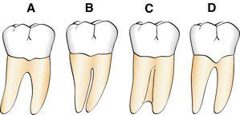

Slide 11
LOCAL ANATOMIC FACTORS
ROOT TRUNK LENGTH
distance from the cementoenamel junction to the entrance of the furcation .
short root trunks may be more accessible to maintenance procedures, and may facilitate some surgical procedures.
Alternatively, long root trunks or fused roots ....difficult to treat.

Slide 12
ROOT LENGTH
Teeth with long roots and short to moderate root trunk length are more readily treated because sufficient attachment remains to meet functional demands.

Slide 13
ROOT FORM
Interradicular Dimension
fused roots...difficult
Teeth with widely separated roots...more readily treated.

Slide 14
ANATOMY OF FURCATION
The presence of bifurcational ridges,
a concavity in the dome,
accessory canals.....complicates treatment and periodontal maintenance.
Odontoplasty to reduce or eliminate these ridges may be required during surgical therapy for an optimal result.

Slide 15
CERVICAL ENAMEL PROJECTIONS ... Masters and Hoskins in 1964
Grade I: The enamel projection extends from the cementoenamel junction of the tooth toward the furcation entrance.
Grade II: The enamel projection approaches the entrance to the furcation. It does not enter the furcation, and therefore no horizontal component is present.
Grade III: The enamel projection extends horizontally into the furcation

Slide 16
PATTERN OF ATTACHMENT LOSS
Horizontal bone loss can expose the furcation as thin facial/lingual plates of bone that may be totally lost during resorption.
Alternatively, areas with thickened bony ledges may persist and predispose to the development of furcations with deep vertical components

Slide 17
PATTERN OF ATTACHMENT LOSS
Complex multiwalled defects with deep, interradicular vertical components may be candidates for regenerative therapies.
Alternatively, molars with advanced attachment loss on only one root may be treated by resective procedures .

Slide 18
TREATMENT
Objectives:
(1) to facilitate maintenance,
(2) to prevent further attachment loss, and
(3)to obliterate the furcation defects as a periodontal maintenance problem.
The selection of therapeutic mode varies with the class of furcation involvement, the extent and configuration of bone loss, and other anatomic factors.

Slide 19
Therapeutic Classes of Furcation Defects
Class I: Early Defects
conservative periodontal therapy.
Because the pocket is suprabony and has not entered the furcation, oral hygiene, scaling, and root planing are effective.
Any thick overhanging margins of restorations, facial grooves, or CEPs should be eliminated by odontoplasty, recontouring, or replacement.

Slide 20
Class II
Shallow horizontal involvement without significant vertical bone loss usually responds favorably to localized flap procedures with odontoplasty and osteoplasty.
Isolated deep class II furcations may respond to flap procedures with osteoplasty and odontoplasty. This reduces the dome of the furcation and alters gingival contours to facilitate the patient’s plaque removal

Slide 21
Classes II to IV: Advanced Defects
Nonsurgical treatment is usually ineffective because the ability to instrument the tooth surfaces adequately is compromised.
Periodontal surgery, endodontic therapy, and restoration of the tooth may be required to retain the tooth.

Slide 22
SURGICAL THERAPY
ROOT RESECTION
indicated in grade II to IV furcation involvements.
may be performed on vital teeth or endodontically treated teeth.

Slide 23
Indications and contraindications for root resection ........by Bassaraba
1. Teeth that are of critical importance to the overall dental treatment plan.
Examples: abutment Teeth

Slide 24
2. Teeth that have sufficient attachment remaining for function.
Molars with advanced bone loss in the interproximal and interradicular zones, unless the lesions have three bony walls, are not candidates for root amputation.

Slide 25
3. Teeth for which a more predictable or cost-effective method of therapy is not available.
Examples are teeth with furcation defects that have been treated successfully with endodontics but now present with a vertical root fracture, advanced bone loss, or caries on bone root.

Slide 26
4. Teeth in patients with good oral hygiene and low activity for caries are suitable for root resection.

Slide 27
Which Root to Remove....??
Remove the root(s) that will eliminate the furcation and allow the production of a maintainable architecture on the remaining roots.

Slide 28
Remove the root with the greatest amount of bone and attachment loss.
X Teeth with uniform advanced horizontal bone loss are not suitable for root resection.
Remove the root that best contributes to the elimination of periodontal problems on adjacent teeth.

Slide 29
Remove the root with the greatest number of anatomic problems, such as severe curvature, developmental grooves, root flutings, or accessory and multiple root canals.
Remove the root that least complicates future periodontal maintenance.

Slide 31
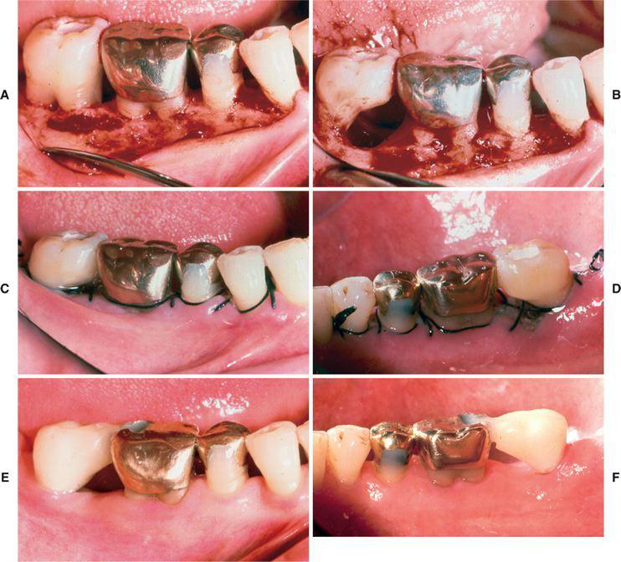

Slide 32
HEMISECTION
splitting of a two-rooted tooth into two separate portions.
Bicuspidization or separation .....because it changes the molar into two separate roots.
most likely to be performed on mandibular molars with buccal and lingual class II or III furcation involvements.

Slide 33
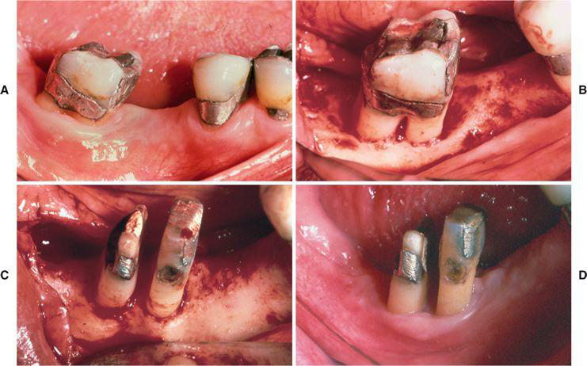

Slide 34
RECONSTRUCTION
deep two-walled or significant three-walled components.
These vertical bony deformities respond favorably to a variety of other surgical procedures, including debridement with or without membranes and bone grafts.

Slide 35
EXTRACTION
The extraction of teeth with through-and-through furcation defects (classes III and IV) and advanced attachment loss.

Slide 36
SUMMARY
The keys to long-term success appear to be thorough diagnosis, selection of patients with good oral hygiene, and careful surgical and restorative management.

Slide 37
REFERENCES
Newman MG, Takei HH, Klokkevold PR, Carranza FA. Carranza’s clinical periodontology, 10th ed. Saunders Elsevier; 2007.
Lindhe J, Lang NP and Karring T. Clinical Periodontology and Implant Dentistry. 6th ed. Oxford (UK): Blackwell Publishing Ltd.; 2015.
Newman MG, Takei HH, Klokkevold PR, Carranza FA. Carranza’s clinical periodontology, 13th ed. Saunders Elsevier; 2018.

